Slide 1
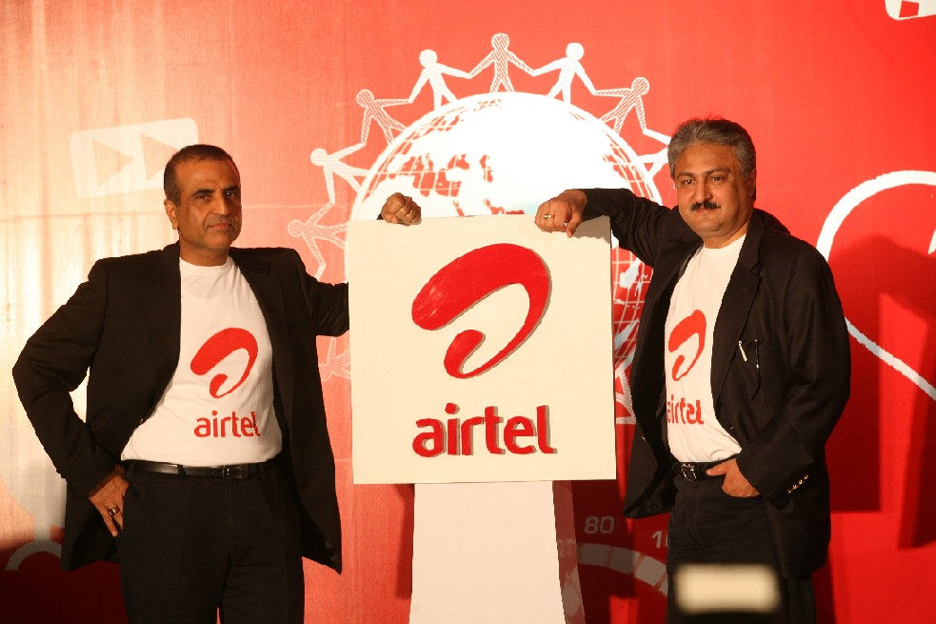
Bharti Airtel Ltd

Slide 2
Introduction
Bharti Airtel Limited, commonly known as Airtel is an Indian telecommunications company that operates in 20 countries across South Asia, Africa and the Channel Islands.
It operates a GSM network in all countries, providing 2G or 3G services depending upon the country of operation.
Airtel is the fourth largest telecom operator in the world with about 300 million subscribers across 20 countries at the end of June 2014. It is the largest cellular service provider in India, with over 224 million subscribers as of August 2014. Airtel is the 3rd largest in-country mobile operator by subscriber base, behind China Mobile and China Unicom.

Slide 3
Airtel is the largest provider of mobile telephony and second largest provider of fixed telephony in India, and is also a provider of broadband and subscription television services. It offers its telecom services under the Airtel brand and is headed by Sunil Bharti Mittal.
Bharti Airtel is the first Indian telecom service provider to achieve this Cisco Gold Certification. To earn Gold Certification, Bharti Airtel had to meet rigorous standards for networking competency, service, support and customer satisfaction set forth by Cisco.

Slide 4
The company also provides land-line telephone services and broadband Internet access (DSL) in over 96 cities in India. It also acts as a carrier for national and international long distance communication services. The company has a submarine cable landing station at Chennai, which connects the submarine cable connecting Chennai and Singapore.

Slide 5
Vision & Mission
Vision:
  To build India's finest business conglomerate by 2020.
Mission:
  We will meet the mobile communication needs of our customers through:
  Error- free service delivery
  Innovative products and services
  Cost efficiency

Slide 6
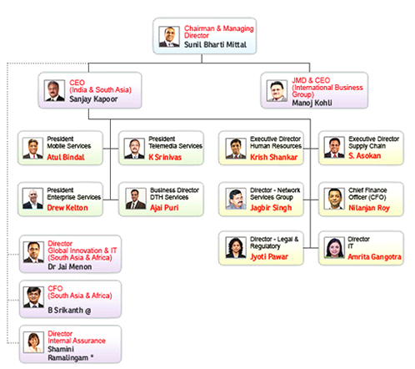
Organizational Structure

Slide 7
New structure to drive the next phase of company’s growth
    Creation of B2C and B2B business verticals for enhanced business efficiency and employee value
    Transformation from a ‘technology’ facing organisation structure to a ‘customer’ facing one
    Will provide enhanced empowerment to employees

Slide 8
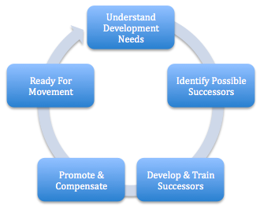
Planning

Slide 9
Innovation
It unveiled new card for Mecca pilgrims in 2004.
Airtel introduced BlackBerry Connect in India in 2005.
First telecom firm to step into television distribution business.
The ‘Caller Tunes’ service was first launched by airtel.
Introduced BlackBerry Connect to India.
Tied up with Apple Inc. to bring the popular iPhone to India.

Slide 10
Strategy of implementation of plan
The company follows a mantra of focusing on their core competencies and outsourcing the rest. It is known for being the first mobile phone company in the world to outsource everything except marketing and sales and finance.
Very clear and transparent behavior.

Slide 11
Decision Making
Airtel created an innovative business model that has produced extremely strong revenue growth and profitability since its founding in 1995.
How did the company do it?
What were the innovations that propelled Airtel to the dominant position in the fiercely competitive Indian wireless market?

Slide 12
Airtel invented a new measure of success in the global telecom industry when it moved away from ARPU (average revenue per user) towards the micro-unit of telecom: the minute.
This departure from the conventional wisdom in the industry can be traced to a 2002 executive gathering, where two major decisions were made.
First, the Airtel management team decided to pursue a path to achieve the lowest per-minute cost in the industry.
second, the company decided to outsource all areas of the business that it felt were not its core competencies.

Slide 13
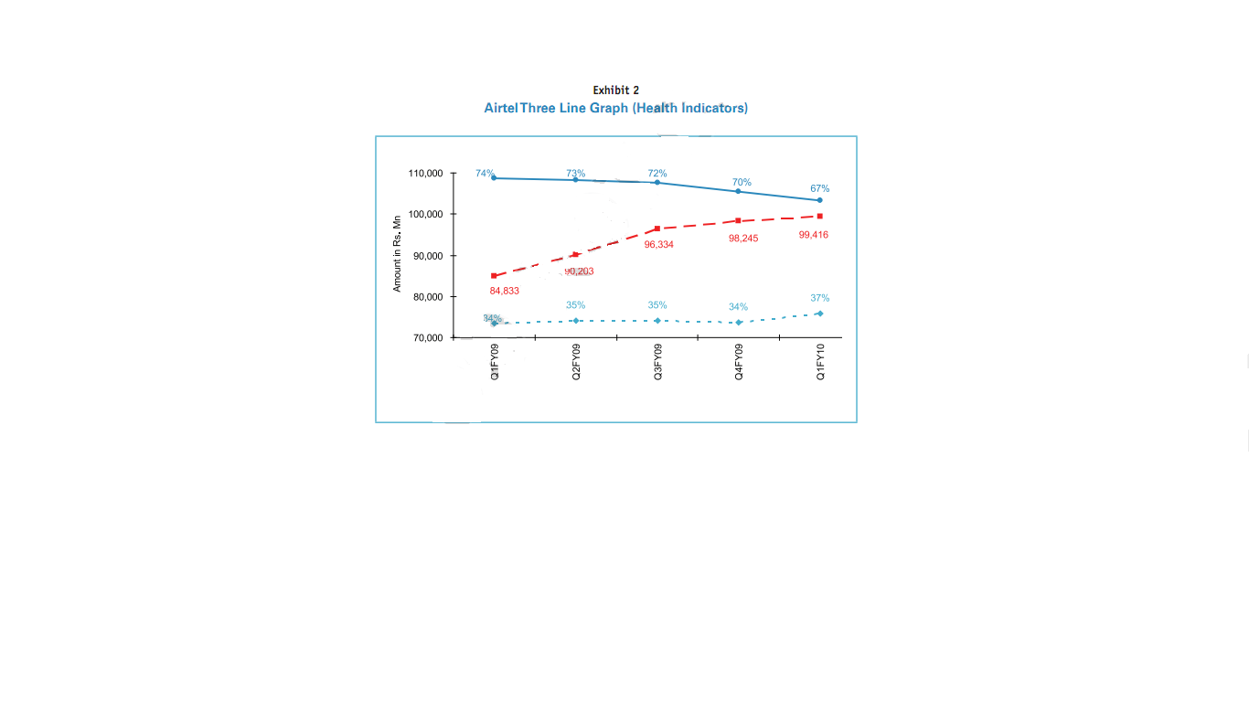
1st Decision
→To pursue the lowest pricing, Airtel introduced a graph with three lines, shown in Exhibit 2, which was developed in-house as a component of the company’s performance dashboard.
→The graph plots Gross Revenues, Operating Expenses to Gross Revenue (Operating Efficiency), and Revenue to Capital Expenditures (Capital Productivity). The team used this to measure success instead of the industry standard metric of ARPU. The graph began to be published throughout the organization and externally.

Slide 14
2nd Decision
In terms of making the decision to outsource its non-core functions, the executive team first identified five areas that it considered fundamental to its success:
1)Customer management
2)People motivation
3)Financial management
4)Regulatory management
5)Brand management

Slide 15
Key Responsibilities
Besides remuneration packages and other benefits of the executive directors, the HR committee also oversees the functions related to human resource matter of the company.
The key responsibilities of the HR committee include the following:
  Recruitment and retention strategies for employees;
  Employee development strategies;
  Compensation and performance targets for the Chairman and Managing Director, CEO(International) & Joint Managing Director and CEO(India & South Asia);

Slide 16
  All human resource related issues;
  Other key issues/matters as may be referred by the Board or as may be necessary in view of clause 49 of the listing agreement or any other statutory provisions.

Slide 17
Strengths
Bharti Airtel has more than 264 million customers (July 2014). It is the largest cellular provider in India, and also supplies broadband and telephone services - as well as many other telecommunications services to both domestic and corporate customers.
Other stakeholders in Bharti Airtel include Sony-Ericsson, Nokia - and Sing Tel, with whom they hold a strategic alliance. This means that the business has access to knowledge and technology from other parts of the telecommunications world.

Slide 18
Weaknesses
An often cited original weakness is that when the business was started by Sunil Bharti Mittal over 20 years ago, the business has little knowledge and experience of how a cellular telephone system actually worked. So the start-up business had to outsource to industry experts in the field.
Until recently Airtel did not own its own towers, which was a particular strength of some of its competitors such as vodafone Essar. Towers are important if your company wishes to provide wide coverage nationally.

Slide 19
Price Competition from BSNL and MTNL. Airtel is tough competition from the operators like BSNL and MTNL as these two operators are offering services at a low rate.
Untapped Rural market. Although Airtel have strong Presence throughout the country but still they are far away from the Indian rural part and generally this part is covered by BSNL so indirectly Airtel is loosing revenue from the rural sector.

Slide 20
Opportunities
The company possesses a customized version of the Google search engine which will enhance broadband services to customers. The tie-up with Google can only enhance the Airtel brand, and also provides advertising opportunities in Indian for Google.
Global telecommunications and new technology brands see Airtel as a key strategic player in the Indian market. The new iPhone will be launched in India via an Airtel distributorship. Another strategic partnership is held with BlackBerry Wireless Solutions.

Slide 21
Despite being forced to outsource much of its technical operations in the early days, this allowed Airtel to work from its own blank sheet of paper, and to question industry approaches and practices - for example replacing the Revenue-Per-Customer model with a Revenue-Per-Minute model which is better suited to India, as the company moved into small and remote villages and towns.
Bharti Airtel is embarking on another joint venture with Vodafone Essar and Idea Cellular to create a new independent tower company called Indus Towers. This new business will control more than 60% of India's network towers. IPTV is another potential new service that could underpin the company's long-term strategy.

Slide 22
Threats
Airtel and Vodafone seem to be having an on/off relationship. Vodafone which owned a 5.6% stake in the Airtel business sold it back to Airtel, and instead invested in its rival Hutchison Essar. Knowledge and technology previously available to Airtel now moves into the hands of one of its competitors.
Bharti Airtel could also be the target for the takeover vision of other global telecommunications players that wish to move into the Indian market.

Slide 23
The quickly changing pace of the global telecommunications industry could tempt Airtel to go along the acquisition trail which may make it vulnerable if the world goes into recession. Perhaps this was an impact upon the decision not to proceed with talks about the potential purchase of South Africa's MTN in May 2008. This opened the door for talks between Reliance Communication's Anil Ambani and MTN, allowing a competing Indian industrialist to invest in the new emerging African telecommunications market.

Slide 24
Future Plan
Bharti Airtel became the world’s fourth largest mobile player With acquisition of Zain Telecom’s African business is now planning to invest over US$ 100 Million in the Malawi telecommunication industry in the next three years to improve coverage and reach out to Malawi’s rural farmers and help the country’s economy grow. Company has also revealed that by this investment and business plan.
Company’s wish to improve local call rates.

Slide 25
Bharti Airtel, an Indian telecommunications company, has been awarded a license to operate 2G and 3G GSM mobile services in Rwanda and plans to invest over US$ 100 million in Rwanda in the next three years.

Slide 26
Thank
You

